Slide 1
Analysis of Spider-Man: Across the Spider-Verse Author: Tiberiu Rociu
1. Introduction
The aims of this project are to further explore a special movie to me, Spider-Man: Across the Spider-Verse. It is not a literary analysis, but a technical one, meant to show how colourful it is, how popular its soundtrack is, and other interesting facts about the movie that a fan might find interesting.
This infographic made out of passion is intended mainly for other fans of the movie, since the technical representation of data pulled from the movie doesn’t truly highlight why the movie is special. It only aims to enhance that belief. For an unfamiliar audience, this infographic can still potentially convince them to watch the movie, as there are direct technical comparisons with another popular movie, Spider-Man: No Way Home, where Across the Spider-Verse arguably comes out on top.
The questions that drove this project are:
1. What are some unique visualisations that can highlight the colourful style of the movie?
2. How does Across the Spider-Verse’s style visually compare with another Spider-Man movie?
3. What other colour technical data can be highlighted?
4. What kind of interesting facts could be mentioned about the movie’s script?
5. How does the movie’s soundtrack compare with a more popular Spider-Man movie?
Questions categories: Visual, Script, Audio

Slide 2
2.1. Data Description — Sources
1. Movie (Spider-Man: Across the Spider-Verse)
2. Movie (Spider-Man: No Way Home)
Both movies come from a digital copy of mine and are in the MKV format. Having a digital copy of them provides the freedom to manipulate the video and audio, and more importantly, to extract data from it.
3. Screenplay of Spider-Man: Across the Spider-Verse
The movie’s screenplay is the official document provided by Sony in a PDF format, found through Google. I originally hoped to extract this data from the movie’s subtitles, but that was too inconsistent for a Python script to determine which line belongs to which character. This PDF proved to be a much better option, after some manual cleaning of the text, but more on this in the Data Loading & Cleaning part.
4. Spotify API
The Spotify API provided the album and song details needed, and its data shape was determined by me when writing the Python script for the API calls.
2.1. Data Description — Data files
Script:
Script Spiderman.txt: A text file with all the lines and its speaker.
character_lines.csv: Used Python to extract the lines and their speaker from the Script Spiderman.txt file.
character_statistics.csv: Used Python to analyse the lines and create a table with character name, total words spoken, lines delivered, and their word percentage for the entire script.

Slide 3
2.2. Data Description — Data files (cont’d)
Movies:
Frames / Frame cropped / Pixel collage / Pixel collage bigger (sample): Four folders containing samples of frames extracted from the movie, cropped frames with removed black bars, and the pixel collages with the top 15 most dominant colours of each frame created in Python. I only added a sample for each because of their large total size. There is a set of folders for each movie, without the Frame cropped for No Way Home, since it didn’t need it.
frames_dominant_colors_spiderverse.csv and frames_dominant_colors_nowayhome.csv: These tables were created using a Python script that analyses a frame for its 15 most dominant colours. For each frame, there are 15 features/columns that store a HEX value.
color_analysis_results.csv: Used Python to create a table with the number of unique colours for each movie, how many warm and cool colours, and an average lightness and brightness of all colours.
Spotify:
albums_data.csv: Data with details for the songs on the three albums of both movies. Although it contains various features for each song, such as Tempo, Key, Loudness, etc., only the Movie, Track Name, and Popularity were used for this project. Creating a strong story around the other features, I decided, would’ve required a lot of research to provide the right context.
albums_data_cleaned.csv: Same data as albums_data.csv but with the track names cleaned in Python.
top_10_songs.csv: Used Python to create a top 10 song list for each movie, based on Popularity feature.

Slide 4
3.1. Visualisation plan — Important data features
For the infographic, the variables that are the most important are:
1. The dominant colours of the movie’s frames, showcased in a visual, easy to understand manner.
The collage created should have an immediate effect on the viewer, instantly creating the impression of how colourful the movie is or isn’t.
I chose a collage instead of a graph representation such as a bubble chart, because of the large amount of data for all the frames that would potentially lead to a cluttered depiction otherwise. I decided that a purely visual representation of the colours translates the point much better than a technical graph could.
This method also allows for a side-by-side comparison of two movies, comparing their collages and making the point without having to analyse data from a graph.
Both movie collages are created with the same Python script method, sampling every 24 frames and calculating the dominant colours, ensuring there is no bias for the colours picked. The format of both movies is also the same, MKV with a standard dynamic range (SDR), guaranteeing that the colours won’t be unfairly darker if one movie would be in high dynamic range (HDR).
2. Unique colours comparison.
Following on the data table created from the previous step, I could easily calculate the unique colours for each movie, how many cool and warm colours there are in the set, and an average lightness and brightness of each set.
Similarly, both movies are calculated using the same formula, resulting in no bias in the final numbers.
For this static categorical data with a few features, I felt that a bar chart comparing the two movies’ data is the most appropriate solution.
I chose distinct colours for each movie, with a legend explaining the movie’s designated colour. The basic rules are also followed, ensuring there is a zero on the axis, that each category is labelled, that a title is present, and that each bar value has the actual value attributed to it for detailed inspection.
3. Words spoken in the screenplay.
The words spoken feature found in the Python generated character_statistics.csv, is the most important feature that is showcased in the graph. Similar to the previous bar plot, this one also follows the basic rules mentioned, having clear axis labels and distinct colours for each character.
There is no bias towards any character, as all of their words are calculated using a Python script that analyses their word count.

Slide 5
3.1. Visualisation plan — Important data features (cont’d)
4. Most common screenplay words.
I wanted to showcase the most common words of the screenplay, and I found that a word bubble provides a more visual representation when compared to other graphs.
To make the word bubble more appealing and fitting to the Spider-Man theme, I decided to make it in the shape of the main character, Miles Morales. There are no word clippings, since Python allows custom masks for its word bubble creation.
To better showcase the movie’s unique words, I decided to cleanup the screenplay by removing common stopwords in the English language, and a few extra ones added manually. This arguably creates a bias towards other words, but I find that it is worth the trade off for this technicality, since a fan of the movie or a viewer will care more about what makes the screenplay unique, rather than a non-biased representation that doesn’t add as much value.
The colour scheme chosen contrasts the dark background quite well, making the words legible for a viewer.
5. Soundtrack popularity comparison.
Wanting to showcase the amazing soundtrack that Spider-Man: Across the Spider-Verse has, turned out to be more challenging than initially expected. The various features that the Spotify API provided for each song proved to be hard to contextualize. Thus, the feature that I focus on is the Popularity one for each of the movie.
With the data originally represented with a bubble graph, after advice and consideration, the final graph choice is a tree graph, as the bubble graph made it harder to distinguish how much more popular one movie is from another. The tree graph does a much better job showcasing this fact, making it easier for a viewer to understand the clear winner.
To keep the graph uncluttered and legible, I decided to focus only on the top 10 songs for each movie, otherwise this might’ve lead to accessibility issues where it is hard to distinguish songs from one another.
Similarly to other graph descriptions, this one also follows the expected basic concepts, with clear distinct colours, a legend, title, and the song names embedded in each shape.

Slide 6
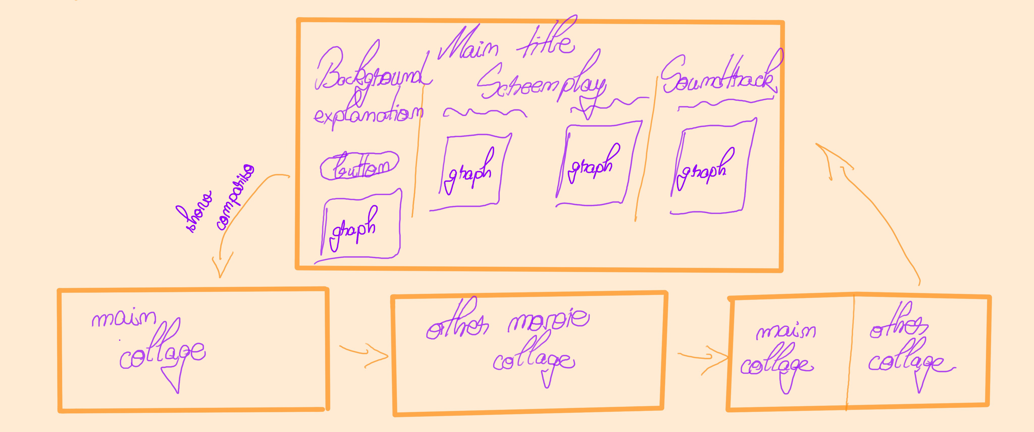
3.2. Visualisation plan — Data presentation
1. Platform and Design.
The infographic had to be interactive, as I wanted to main graphs and number stories to be on a single page, but also required additional space to showcase the large pixel collages.
The pixel collage was originally a single strip animated on the side of the main page, but this proved to be distracting and hard to animate, considering that its resolution when scaled down was 240x132776. In the end, I found that a separate page with the all the collage strips had a bigger visual impact, than animated smaller snippets at the time.
To make this project accessible, I chose Figma, since it allows for easy interaction and transitions between pages, making it easier for a viewer to consume all the data presented.
2. Number stories.
Each number story is deduced from the data created and is meant to provide more insight in the graphs shown. As these insights are drawn from the data, they don’t provide any bias to the stories, just serve as extra exposition.
3. Initial project basic sketch, showing structure and interaction flow.

Slide 7
4.1. Data manipulation — Movie analysis
The movie analysis requirements:
Original format: MKV video files.
Required format: Table with dominant colours in HEX format.
Final visualisation: Pixel collage of 15x20, with 15 rows of coloured squares per column; Bar plot with unique colours and other statistics.
Extracting and cropping the frames from the video file.
Files used: cropFramesCommand.txt and extractFramesCommand.txt
I originally tried to use the library OpenCV (cv2) from Python to extract the frames, as seen in the extractFrames.py script, but this is CPU based and couldn’t get it to use the GPU instead. This made the process extremely lengthy and resource intensive.
In the end I used FFmpeg, which can benefit from the GPU, drastically improving the process. Example of command line used:
ffmpeg -i “video_file_path" -vf "select=not(mod(n\,1))" -vsync vfr -threads 10 “output_folder_path\frame_%05d.jpg"
Cropping the frames, to remove the black bars and to avoid unnecessary processing and to avoid colour analysis conflicts, I’ve use the same FFmpeg software, using this command line:
Get-ChildItem “frames_input_folder\*.jpg" | ForEach-Object {
$inputFile = $_.FullName
$outputFile = “frames_output_folder\$($_.BaseName)_cropped.jpg"
ffmpeg -i "$inputFile" -vf "crop=in_w:in_h-560:0:280" "$outputFile" }
2. Calculating dominant colours and saving the colour palette.
Files used: saveColorPallete.py and saveColorPalleteImproved.py
The script loops through all the sorted frames, it resizes each frame to a 300x300 resolution, to improve performance by reducing the amount of pixels while also maintaining the dominant colours. It then calculates the top dominant colours using KMeans, an algorithm that clusters similar colours and represents each cluster with a dominant RGB value.
The list of dominant colours is saved appended to a csv file to create the data table, and the values are also added to a plot. When the plot reaches a set threshold, it is saved, and a new one is created to contain the next frames.

Slide 8
4.1. Data manipulation — Movie analysis (cont’d)
3. Create stacked collages.
Files used: createCollageColorPallete.py
I wrote this script to easily stack multiple smaller pixel collages and create a bigger one. Doing this manually would’ve take a longer time, and this proved to be even more useful than anticipated, since Figma has limitations of image resolutions, and I had to tweak the number of stacked collages multiple times because of this.
The script cycles through the sorted collage images, and using the Pillow (PIL) Python library, I stack multiple images to a set number threshold. The larger image is then saved and a new one is created up until all the collage images are stacked.
4. Calculating colours statistics (unique, warm, cool, average brightness and lightness).
Files used: analyzeUniqueColours.py
I applied similar techniques to the other scripts, looping through the sorted images and scaling them down before analysing the pixels. The pixels are stored in a numpy array and all the non-white HEX values are added to a set. The unique set HEX values will then be converted to HSL to extract their lightness and brightness, and also assign each colour to a warm or cool counter, depending on a primary colours threshold.
This data is saved to a csv with the 6 features: Dataset, Warm Colours, Cool Colours, Average Lightness, Average Brightness, and Total Unique Colours.
5. Plot the colours statistics.
Files used: movieColorGraphs.py
I read the color_analysis_results.csv file and add the values to a bar plot, using the Matplotlib Python library. In the final bar plot version, for aesthetic reasons, I remove all the labels, title, ticks, and other text. I added all these details in Figma for better text scalability, and matched those with an initial version of the plot that contained them.

Slide 9
4.2. Data manipulation — Screenplay analysis
The screenplay analysis requirements:
Original format: PDF.
Required format: Table with character column and delivered lines columns.
Final visualisation: Bar plot with word count; Spider-Man shaped word bubble showing most common words.
1. Getting the script in a .txt format.
Files used: none
Originally I hoped to transform the PDF into an XML file and use Python to determine which line belongs to which character. The XML conversion didn’t work out, as the text wasn’t placed correctly in the XML tags, and it would’ve been more work to create a deterministic reliable script to extract the lines.
I copied the entire PDF file into a .txt file and manually removed the unnecessary text, leaving only the character names and their lines, in the same sequence as they were in the script. The final format can be seen in the Script Spiderman.txt file.
2. Getting the data tables for the script.
Files used: scriptAnalysis.py
Opened the Script Spiderman.txt file and looped through each line in the file, knowing that line is either a character name or a movie line. I used a regular expression to match the character names in capitals, account for their different formats (some containing dots, multi-word names, or extra special characters). If a text line is in all caps and longer than 4 words, this means it’s a dialogue line and will be treated as such. Everything else will be treated as dialogue and added to their appropriate character (the name of the last character name found). The final dictionary of characters and their lines is saved in the character_lines.csv file, with two columns for Character and Line.
I also generate the character_statistics.csv file by counting the total word, lines spoken, and that character’s dialogue percentage for the entire script.
2. Word cloud and bar plot of script.
Files used: scriptAnalysis.py
In the same file used for processing, I pass my data structures and create a word cloud using a custom shape. The custom shape with the main character, Miles Morales, I created by passing a frame into Paint 3D and using the magic tool to get just the character’s outline.

Slide 10
4.2. Data manipulation — Screenplay analysis (cont’d)
2. Word cloud and bar plot of script (cont’d).
Using my custom shape with the character outline, I can pass this and the text to the WordCloud Python library and create a representation of the most frequent words in the script. Before passing the text to WordCloud, I did some basic stop words removal, to ensure that basic connection words won’t overshadow the unique words found in the script. Besides using the stop words dictionary provided by the NLTK library, I added a few more myself to remove redundant word not picked up by the library. I finally passed the WordCloud object to a Matplotlib plot and saved it.
I created the bar plot using Matplotlib, and used some custom colours to ensure clear distinction between the characters. Because there are many characters in the script and the plot would become cluttered if all of them are included, I decided to showcase only the top 9 characters, with all the other ones going under the category of OTHER CHARACTERS. The graph, with the removed labels and other text elements, for the same aesthetic reasons mentioned before, is then saved.
3. Script stories data.
Files used: scriptAnalysis.py
To create a few stories about the script, I used the Python object Counter to easily count the frequency of certain words or phrases. Using the Counter object with the cleaned text and two loops, one for individual words and one for phrases, I can get the frequency of a list of words and phrases passed.
4.3. Data manipulation — Soundtrack analysis
1. Spotify song details and top 10 list.
Files used: extractAlbumSpotifyData.py
I used the Spotify Python library to make API calls to the Spotify domain, and search for specific albums. By passing a list of the 3 albums containing the soundtrack for both movies, I can get their unique IDs by selecting the first search result. From each album ID, I can then get all the tracks on that album and extract all the audio features associated with it. Although I am saving many features in the albums_data.csv file, I ended up using only a couple of features for the visualisations.
The Track Names feature required some cleaning, as the name of the songs were too lengthy and contained unnecessary information, that would not fit in the tree graph. Thus, I removed the all the non-ASCII characters and everything after a parenthesis or dash.

Slide 11
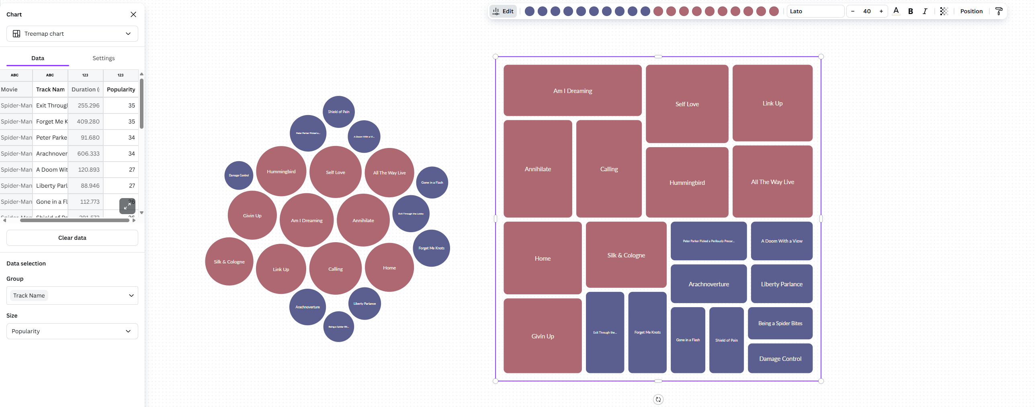
4.3. Data manipulation — Soundtrack analysis (cont’d)
1. Spotify song details and top 10 list (cont’d).
To get the top 10 list of most popular songs for each movie, I used the method .nlargest() of Panda’s dataframe and saved the output to the top_10_songs.csv file. This data I then passed to the Canva website application to create the bubble and tree graph. I chose this option instead of Python because tweaking the graphs to get the desired look in Python turned out to be too cumbersome.

Slide 12
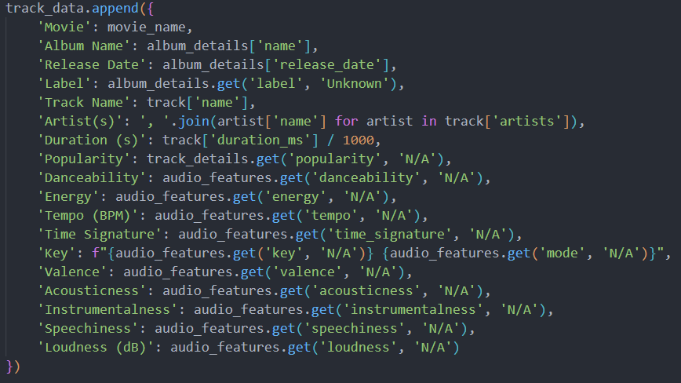
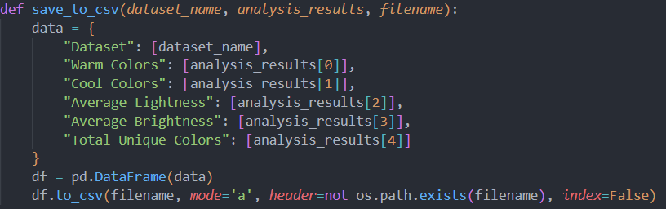
4.4. Data manipulation — Recommended techniques
I added below a single example of the required manipulation techniques that are present in the project.
Missing data handling.
File: extractAlbumSpotifyData.py
When extracting the Spotify song data, I handle potential missing data by replacing it with N/A.
2. Change or creation of a new feature.
File: analyzeUniqueColours.py
I create new features in the color_analysis_results.csv file by computing the total unique colours, warm and cool colours, and average brightness and lightness.

Slide 13
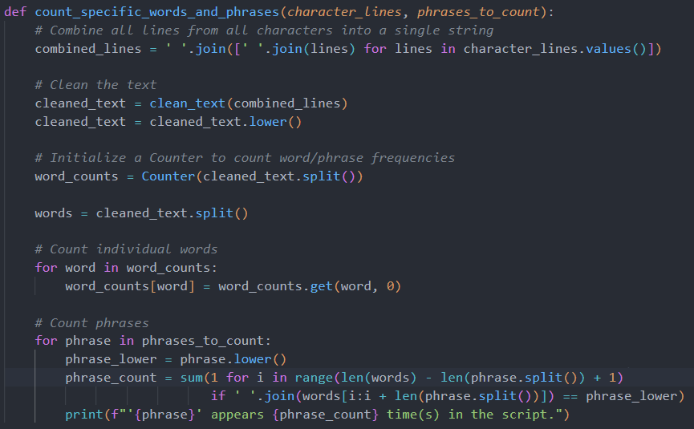
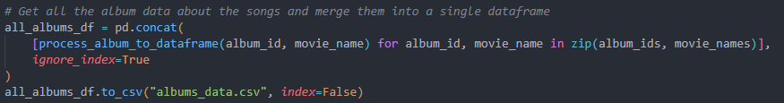
4.4. Data manipulation — Recommended techniques (cont’d)
3. Technique to explore a data file’s rows.
File: scriptAnalysis.py
I cycle through all the rows to count the frequency of specific words or phrases.
4. Data file merge.
File: extractAlbumSpotifyData.py
I merge multiple album details dataframes into a single dataframe before saving it to a csv file.

Slide 14
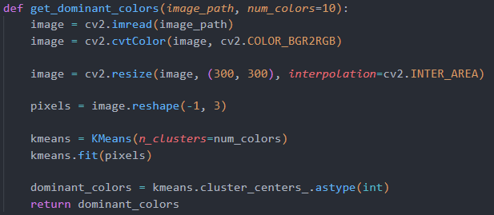
4.4. Data manipulation — Recommended techniques (cont’d)
5. Data aggregation.
File: saveColorPalleteImproved.py
From the numerous pixel values of an image, I aggregate the data and reduce it to a dominant top 15 colours using KMeans, and saving those 15 features in a csv file.
Lastly, the data files are not combined into a single file because they handle various types of data and I found it wouldn’t have made sense to have all the various features in a single file. I categorized the coursework proof by movie, script, and soundtrack analysis, each with the scripts used and data tables.
5. References
1. Lord, P. and Rothman, R. (2018) SPIDER-MAN: INTO THE SPIDER-VERSE Screenplay by. Available at: https://origin-flash.sonypictures.com/ist/awards_screenplays/SV_screenplay.pdf.

